Slide 1
AZ-100.5 Manage Identities

Slide 2
Course Agenda
M01: Managing Azure Active Directory
L01: Azure Active Directory Overview
L02: Self-Service Password Reset
L03: Azure AD Identity Protection
L04: Integrating SaaS Applications with Azure AD
M02: Managing Azure Active Directory Objects
L01: Azure Domains and Tenants
L02: Azure Users and Groups
L03: Azure Roles
L04: Managing Devices
M03: Implementing and Managing Hybrid Identities
L01: Azure Active Directory Integration Options
L02: Azure AD Application Proxy

Slide 3
Manage Identities
Manage Azure Active Directory (AD)
May include but not limited to: Add custom domains; configure Azure AD Identity Protection, Azure AD Join, and Enterprise State Roaming; configure self-service password reset; implement conditional access policies; manage multiple directories; perform an access review
Manage Azure AD objects (users, groups, and devices)
May include but not limited to: Create users and groups; manage user and group properties; manage device settings; perform bulk user updates
Implement and manage hybrid identities
May include but not limited to: Install and configure Azure AD Connect; configure federation and single sign-on; manage Azure AD Connect; manage password sync and writeback
Notes:
In the Welcome section of the student materials is a checklist showing where these areas are covered in the course.

Slide 4
AZ-100.5 Module 01: Managing Azure Active Directory

Slide 5
Lesson 01: Azure Active Directory Overview

Slide 6
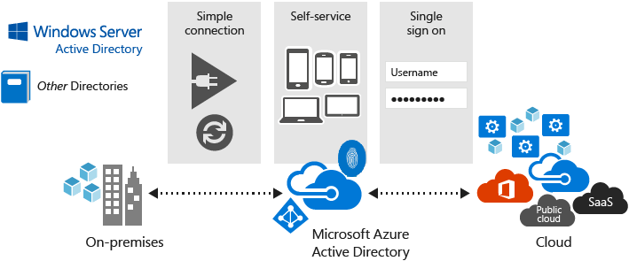
Azure Active Directory
Microsoft’s multi-tenant cloud-based directory and identity management service
Provides SSO access
Identity management capabilities and integration
Integrates with Windows Server Active Directory
Notes:
✔️ If you are an Office365, Azure or Dynamics CRM Online customer, you might not realize that you are already using Azure AD. Every Office365, Azure and Dynamics CRM tenant is already an Azure AD tenant. Whenever you want you can start using that tenant to manage access to thousands of other cloud applications Azure AD integrates with.
For more information, you can see:
What is Azure Active Directory? - https://docs.microsoft.com/en-us/azure/active-directory/active-directory-whatis

Slide 7
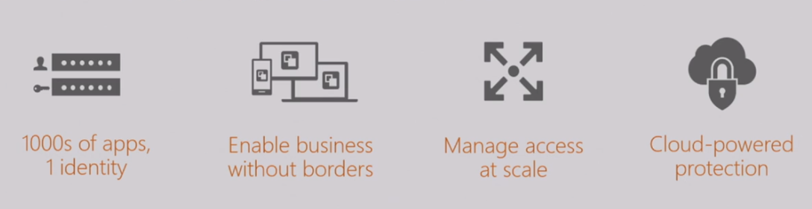
Azure Active Directory Benefits
Single sign-on to any cloud or on-premises web app
Compatible with iOS, Mac OS X, Android, and Windows devices
Protect on-premises web applications with secure remote access
Extend Active Directory to the cloud
Help protect sensitive data and applications
Notes:
✔️ What reasons do you have for considering Azure Active Directory?
For more information, you can see:
The power of common identity across any cloud) - https://myignite.microsoft.com/videos/54694

Slide 8
Azure AD Differences
Azure AD is primarily an identity solution, and designed for HTTP and HTTPS communications
Queried using the REST API over HTTP and HTTPS. Instead of LDAP.
Uses HTTP and HTTPS protocols such as SAML, WS-Federation, and OpenID Connect for authentication (and OAuth for authorization). Instead of Kerberos.
Includes federation services, and many third-party services (such as Facebook).
Azure AD users and groups are created in a flat structure, and there are no Organizational Units (OUs) or Group Policy Objects (GPOs).
Notes:
✔️ Azure AD is a managed service. You only manage the users, groups, and policies. Deploying AD DS with virtual machines using Azure means that you manage the deployment, configuration, virtual machines, patching, and other backend tasks. Do you see the difference? How are they similar?

Slide 9
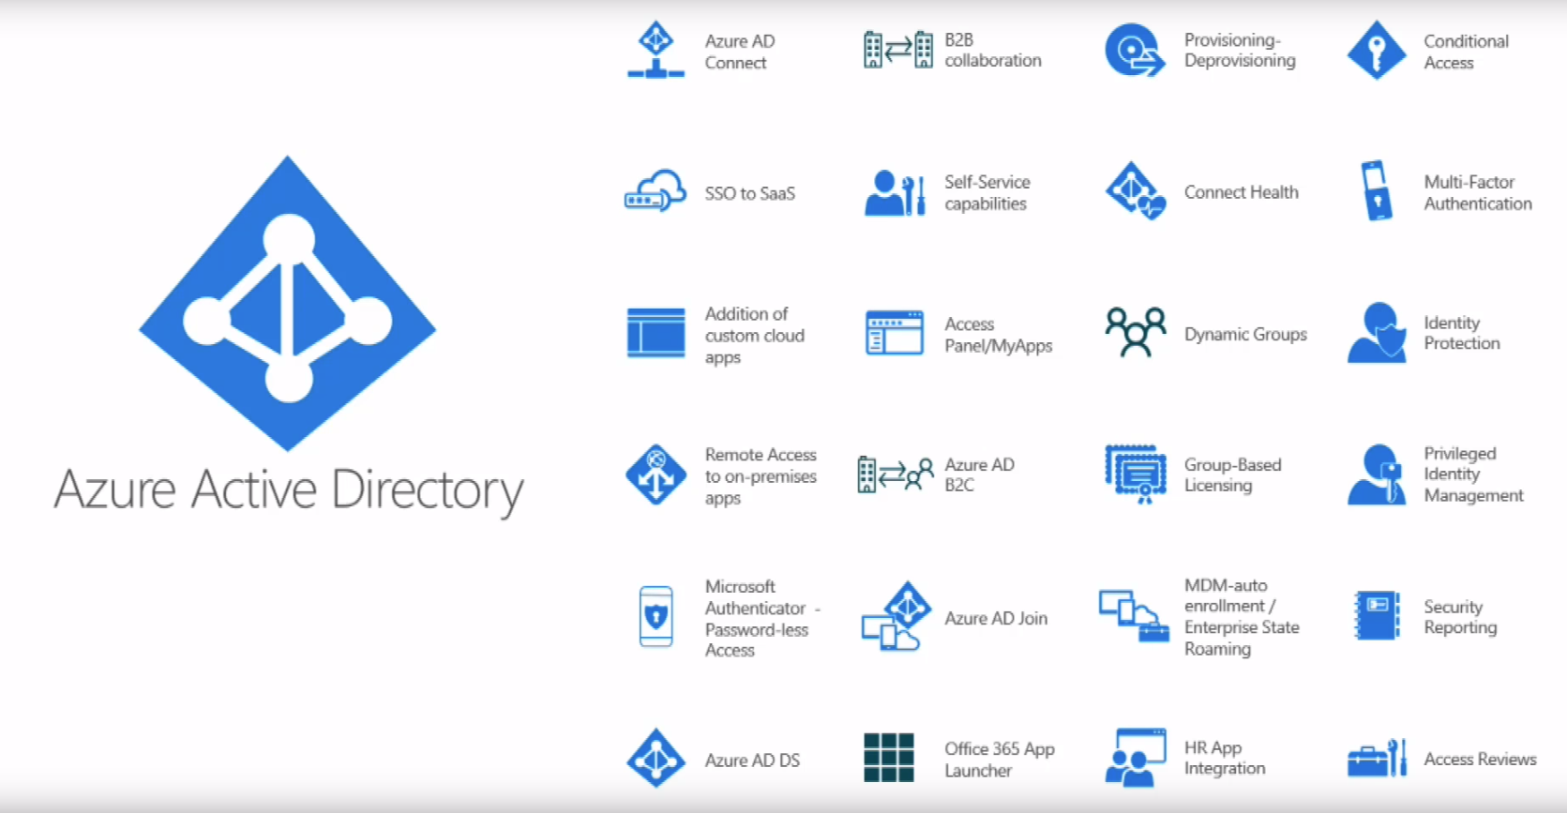
Azure Active Directory Overview
Notes:
Azure AD Overview - https://www.youtube.com/embed/wYtJNjgIXa8

Slide 10
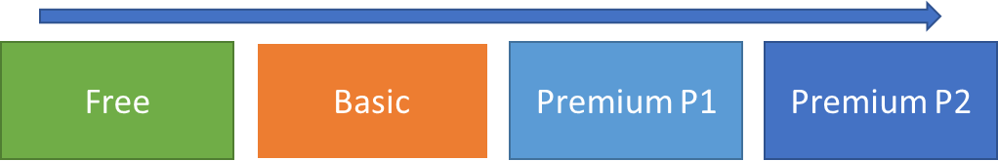
Azure Active Directory Editions
Azure Active Directory Free designed to introduce system administrators to Azure Active Directory.
Azure Active Directory Basic designed for task workers with cloud-first needs, this edition provides cloud-centric application access and self-service identity management solutions.
Azure Active Directory Premium P1 designed to empower organizations with more demanding identity and access management needs.
Azure Active Directory Premium P2 includes every feature of all other Azure Active Directory editions enhanced with advanced identity protection and privileged identity management capabilities.
Notes:
✔️ Did you look through the pricing list to determine which features your organization needs and to compare edition capabilities?
For more information, you can see:
Azure AD Pricing Editions - https://azure.microsoft.com/en-us/pricing/details/active-directory/

Slide 11
When to use Azure AD Join
Aspect | Azure AD Join | Azure AD Domain Services
Device controlled by | Azure AD | Azure AD Domain Services managed domain
Representation in the directory | Device objects in the Azure AD directory. | Computer objects in the AAD-DS managed domain.
Authentication | OAuth/OpenID Connect based protocols | Kerberos, NTLM protocols
Management | Mobile Device Management (MDM) software like Intune | Group Policy
Networking | Works over the internet | Requires machines to be on the same virtual network as the managed domain.
Great for ... | End-user mobile or desktop devices | Server virtual machines deployed in Azure
Notes:
For more information, you can see:
Choose between Azure Active Directory join and Azure Active Directory Domain Services - https://docs.microsoft.com/en-us/azure/active-directory-domain-services/active-directory-ds-compare-with-azure-ad-join

Slide 12
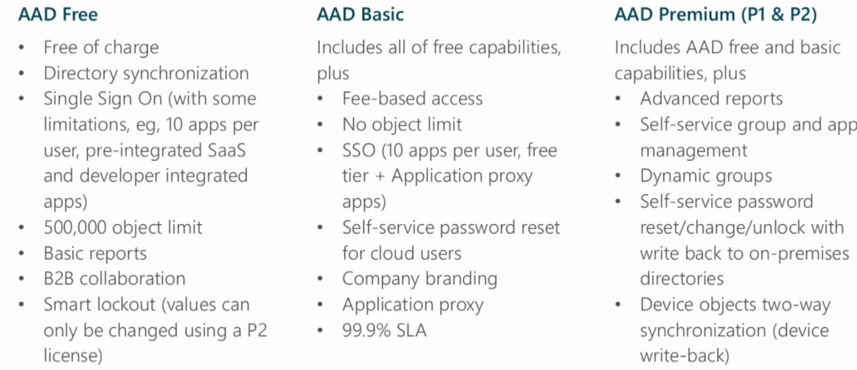
Azure Active Directory Editions
Notes:
Azure AD Editions - https://www.youtube.com/embed/ASijhrPDmGI

Slide 13
Lesson 02: Self-Service Password Reset

Slide 14
Self-Service Password Reset (SSPR)
SSPR supported in Azure AD
SSPR not natively supported in AD DS
On-premises passwords can be reset Azure AD password reset if password writeback is enabled in AD Connect
SSPR enabled and configured in the Azure portal
Notes:
SSPR - https://www.youtube.com/embed/WmItjlblXEA

Slide 15
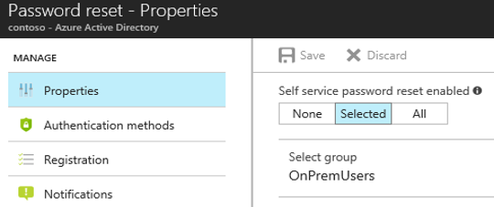
Configuring Self-Service Password Reset
Determine who will be enabled to use self-service password reset
Narrow your selection to specific groups
Notes:
Azure Administrator accounts will always be able to reset their passwords no matter what this option is set to.

Slide 16
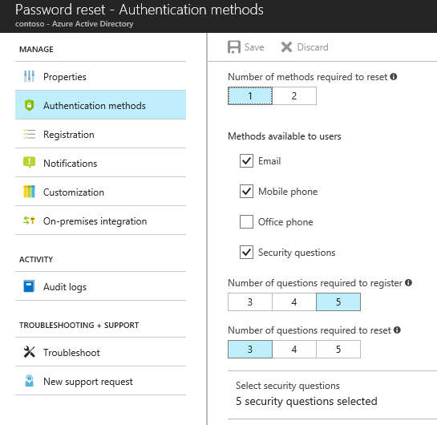
Authentication Methods for Password Reset
Choose the:
Number of authentication methods required to reset a password
Number of authentication methods available to users
Authentication methods include:
Email notification
Text or code sent to phone
Number of security questions to be registered and how many must be correctly answered

Slide 17
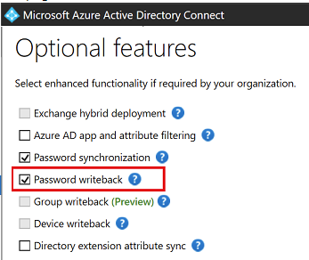
Password Writeback
Use Password Writeback to configure Azure AD to write passwords back to your on-premises Active Directory
A component of Azure AD Connect
Available to subscribers of Premium Azure Active Directory editions
Removes the need to set up and manage an on-premises SSPR solution
Notes:
✔️ Use the link below to read about the password writeback features. Which of the features are you most interested in?
For more information, you can see:
Password writeback overview - https://docs.microsoft.com/en-us/azure/active-directory/authentication/howto-sspr-writeback

Slide 18
Configuring Self-Service Password Reset
Enable SSPR for everyone
Select the authentication methods, security questions
Configure notifications, users and administrators
Configure AD Connect writeback, if applicable
First time user logins must answer the security questions
Test to ensure password reset works
Notes:
Configuring SSPR - https://www.youtube.com/embed/NMmhB-d3t3E

Slide 19
Configuring Self-Service Group Creation
Enable self-service group management
Configure for security groups or just distribution groups
Select the group manager
Test to ensure group creation works
Notes:
For more information about setting up Azure Active Directory for self-service group management, see: https://docs.microsoft.com/en-us/azure/active-directory/active-directory-accessmanagement-self-service-group-management

Slide 20
Lesson 03: Azure AD Identity Protection

Slide 21
Azure Identity Protection
Detect potential vulnerabilities affecting your organization’s identities.
Configure automated responses to detected suspicious actions that are related to your organization’s identities.
Investigate suspicious incidents and take appropriate action to resolve them.
Notes:
Azure Identity Protection - https://www.youtube.com/embed/zI3jn_G0_Ns

Slide 22
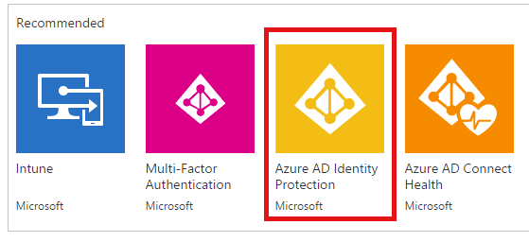
Azure AD Identity Protection
Protect your organization from compromised accounts, identity attacks, and configuration issues.
Get a consolidated view of identity threats and vulnerabilities.
Receive notifications of new identity risks, perform recommended remediation, and automate future response with Conditional Access policies.
Notes:
✔️ Take a minute to enable Azure AD Identity Protection and explore the different capabilities you saw in the previous video. Discuss how these technologies support each other.
For more information, you can see:
Azure Active Directory Identity Protection FAQ - https://docs.microsoft.com/en-us/azure/active-directory/active-directory-identity-protection-faqs

Slide 23
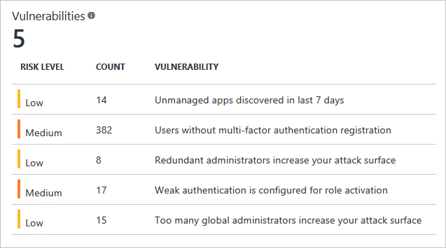
Vulnerabilities Detected
Vulnerabilities are weaknesses in your environment that can be exploited by an attacker
Review risk level, count, and vulnerability
Notes:
Two vulnerabilities are discussed in the student manual. Locate this screen in the portal.
For more information, you can see:
Vulnerabilities detected by Azure Active Directory Identity Protection - https://docs.microsoft.com/en-us/azure/active-directory/active-directory-identityprotection-vulnerabilities
What is Azure Multi-Factor Authentication? - https://docs.microsoft.com/en-us/azure/active-directory/authentication/multi-factor-authentication
Set up Cloud App Discovery in Azure AD - https://docs.microsoft.com/en-us/azure/active-directory/manage-apps/cloud-app-discovery

Slide 24
Enabling Multi-Factor Authentication
Enable MFA for an Azure user account (or multiple accounts)
Add a provider from the MFA Server settings under Azure Active Directory
Choose the usage model and subscription
Additional configuration options include:
Fraud alerts
Notifications
One-time bypass
Use PowerShell to script this when you need to enable MFA for many users
Once MFA is enabled, the user completes the initial configuration process at the next login
Notes:
Setup Cloud App Discovery in Azure AD - https://www.youtube.com/embed/gn6qQCu67FU

Slide 25
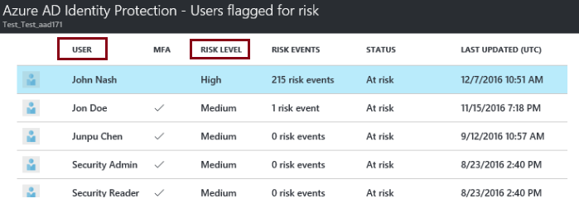
Risky Sign-Ins
Azure AD detects suspicious actions related to user accounts
For each detected action, a risk event is created
Risk events are used to calculate risky sign-ins, and users flagged for risk
Notes:
✔️Azure AD Identity Protection sends two types of automated notification emails to help you manage user risk and risk events: users at risk detected email, and a weekly digest email.
For more information, you can see:
Risky sign-ins - https://docs.microsoft.com/en-us/azure/active-directory/active-directory-identityprotection#risky-sign-ins
Azure Active Directory Identity Protection notifications - https://docs.microsoft.com/en-us/azure/active-directory/active-directory-identityprotection-notifications

Slide 26
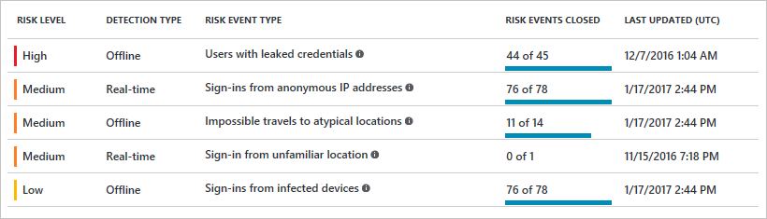
Risks Detected
Users with leaked credentials
Sign-ins from anonymous IP addresses
Impossible travel to atypical locations
Sign-ins from infected devices
Sign-ins from IP addresses with suspicious activity
Sign-ins from unfamiliar locations
Notes:
✔️The insight you get for a detected risk event is tied to your Azure AD subscription. With the Azure AD Premium P2 edition, you get the most detailed information about all underlying detections. With the Azure AD Premium P1 edition, detections that are not covered by your license appear as the risk event Sign-in with additional risk detected.
✔️If you have time, check out the following presentation given at the Ignite 2017 conference. It provides a broad overview of the Azure AD Identity Protection capabilities covered in this lesson. The session is entitled “Shut the door to cybercrime with Azure Active Directory risk-based identity protection.”
For more information, you can see:
Azure Active Directory risk events - https://docs.microsoft.com/en-us/azure/active-directory/active-directory-reporting-risk-events

Slide 27
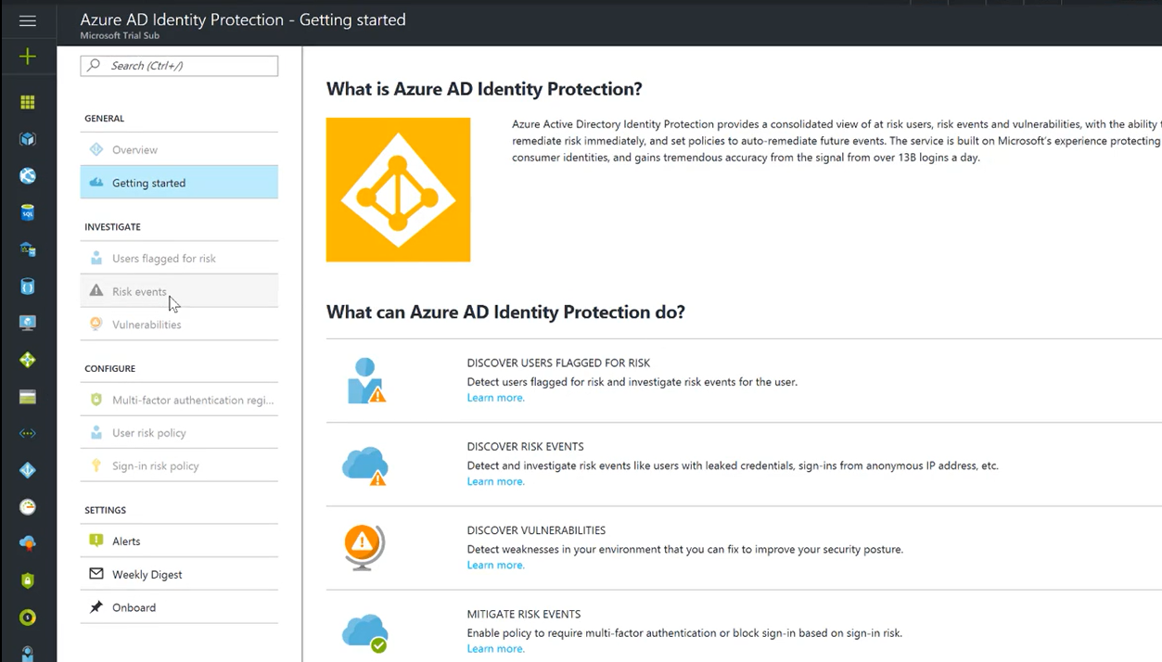
Enabling Azure Active Directory Protection
Notes:
Enabling Azure AD Protection - https://channel9.msdn.com/blogs/Patrick-Wirtzs-Enterprise-Mobility--Security-Series/Enable-Azure-AD-Identity-Protection/player
✔️ This video is from the Enterprise Mobility + Security series on Microsoft’s Channel 9 platform. It discusses the process to enable Azure AD Identity Protection. You’ll learn how this feature can help corporations understand the risk levels of authentication, mitigating them through things such as Azure MFA. Additionally, Azure AD Identity Protection also benefits corporations proactively by searching for compromised credentials and then alerting administrators of the compromise while locking the user account.

Slide 28
Lesson 04: Integrating SaaS Applications with Azure AD

Slide 29
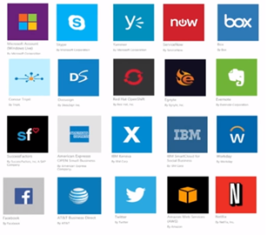
Software as a Service
Allows users to connect to and use cloud-based apps over the Internet
You can “rent” productivity apps and sophisticated business applications
Pay for the use of these apps by subscription or according to the level of use
Notes:
✔️ Begin to think about how users will login to your SaaS applications. Will you be able to implement a single sign-on experience?
For more information, you can see:
What is SaaS? - https://azure.microsoft.com/en-us/overview/what-is-saas/

Slide 30
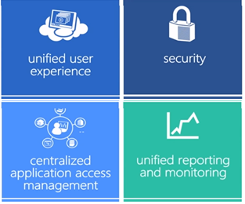
SaaS Advantages
Unified user experience
Security
Centralized application access management
Unified reporting and monitoring
Gain access to applications
Pay only for what you use
Use free client software
Access app data from anywhere
Notes:
✔️ Can you think of any other advantages specific to your organization’s needs?
For more information, you can see:
What is SaaS? - https://azure.microsoft.com/en-us/overview/what-is-saas/

Slide 31
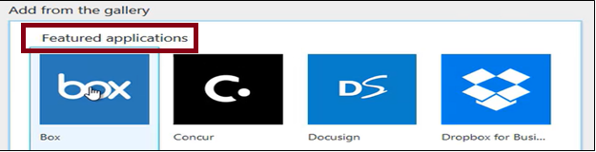
Application Gallery
Automatically create new accounts in the right systems
Automatically deactivate accounts in the right systems
Ensure the identities in your apps and systems are kept up-to-date
Provision non-user objects, such as groups, to applications that support them
Notes:
✔️ Automatic provisioning is a very good thing. Take a minute to read more in the next link.
For more information, you can see:
Azure Active Directory integrated with applications - https://docs.microsoft.com/en-us/azure/active-directory/active-directory-enable-sso-scenario#azure-active-directory-integrated-with-applications
Automate user provisioning and deprovisioning to SaaS applications with Azure Active Directory - https://docs.microsoft.com/en-us/azure/active-directory/active-directory-saas-app-provisioning

Slide 32
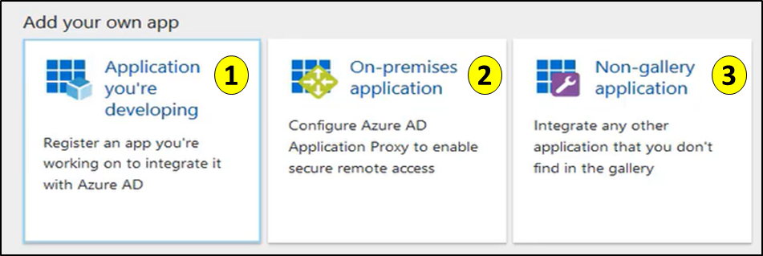
Other Integration Options
Add your own app you are developing and implement federated single sign-on or provisioning
Add an On-premises Application to provide SSO and secure remote access for web applications hosted on-premises
Integrate any other app that supports SAML 2.0 as a federated app, or any application that has an HTML-based sign-in page as a password SSO app
Notes:
For more information, you can see:
Get started with the Azure AD application gallery - https://docs.microsoft.com/en-us/azure/active-directory/active-directory-appssoaccess-whatis#get-started-with-the-azure-ad-application-gallery
Integrating Azure Active Directory with applications getting started guide - https://docs.microsoft.com/en-us/azure/active-directory/active-directory-integrating-applications-getting-started
SaaS application integration with Azure Active Directory - https://docs.microsoft.com/en-us/azure/active-directory/active-directory-saas-tutorial-list

Slide 33
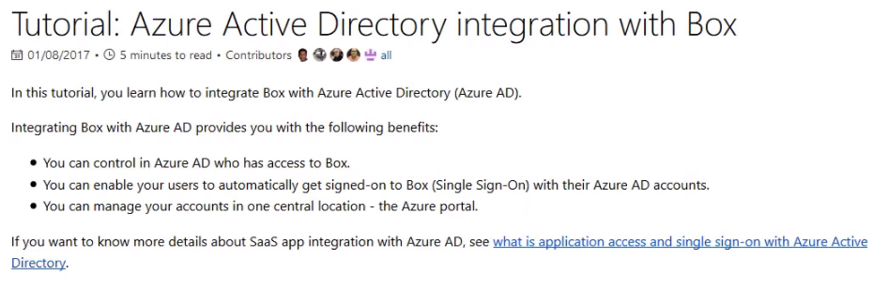
Integrating SaaS Applications
Each application has a tutorial
Notes:
Integrating SaaS Applications - https://www.youtube.com/embed/Mlr7WsqVeQw

Slide 34
SaaS Integration with Azure AD
To help integrate your cloud-enabled applications with Azure Active Directory, we have developed a collection of tutorials that walk you through configuration
https://docs.microsoft.com/en-us/azure/active-directory/saas-apps/tutorial-list
Pick a few apps that interests you and review the integration steps
Notes:
Tutorials - https://docs.microsoft.com/en-us/azure/active-directory/saas-apps/tutorial-list

Slide 35
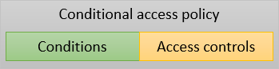
Conditional Access
Enables you to enforce controls on access to apps based on specific conditions
The combination of your conditions with your access controls represents a conditional access policy
Conditions – “When this happens”
Access controls – “Then do this”
Notes:
✔️ Do you think conditional access would be something your organization is interested in?
For more information, you can see:
Conditional access in Azure Active Directory - https://docs.microsoft.com/en-us/azure/active-directory/active-directory-conditional-access-azure-portal
Grant controls - https://docs.microsoft.com/en-us/azure/active-directory/active-directory-conditional-access-controls#grant-controls

Slide 36
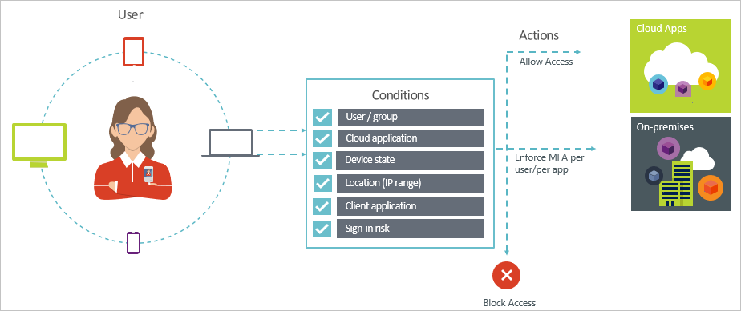
Conditions – Users/Groups
Combine the conditions to get the conditional access policy you need
You can either Block Access altogether or Grant Access with additional requirements
Additional requirements include: MFA, trusted devices, domain-joined devices, and mobile devices using Intune
Notes:
✔️ The Users and Groups condition is mandatory in a conditional access policy. In your policy, you can either select All users or select specific users and groups.
For more information, you can see:
Conditions in Azure Active Directory conditional access - https://docs.microsoft.com/en-us/azure/active-directory/active-directory-conditional-access-conditions

Slide 37
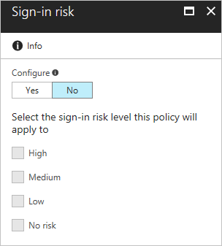
Sign-in Risk Condition
Sign-in risk is an indicator (high, medium, low) that the legitimate owner of an account did not perform a sign-in attempt
Azure AD calculates the risk level during sign-in attempt
Use the sign-in risk level as a condition in a conditional access policy
Must have Azure Active Directory Identity Protection enabled
Notes:
✔️ To use this condition, you need to have Azure Active Directory Identity Protection enabled.
For more information, you can see:
Sign-in risk - https://docs.microsoft.com/en-us/azure/active-directory/active-directory-conditional-access-conditions#sign-in-risk

Slide 38
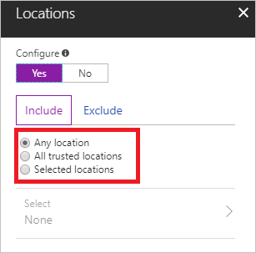
Locations Condition
Define conditions based on the location of the connection attempt
Require MFA for users accessing a service when they are off the corporate network
Block access for users accessing a service from specific countries or regions
Ensure that access to a non-production Azure environment occurs only from a non-production network
Notes:
✔️ If you are interested in the other access conditions that are available take some time to go through the next links.
For more information, you can see:
Locations - https://docs.microsoft.com/en-us/azure/active-directory/active-directory-conditional-access-locations
Cloud Apps - https://docs.microsoft.com/en-us/azure/active-directory/active-directory-conditional-access-conditions#cloud-apps
Device Platforms - https://docs.microsoft.com/en-us/azure/active-directory/active-directory-conditional-access-conditions#device-platforms
Client Apps - https://docs.microsoft.com/en-us/azure/active-directory/active-directory-conditional-access-conditions#client-apps

Slide 39
Lab1: Conditional Access
Requirements
Access to an Azure AD Premium edition
A test account called Isabella Simonsen
Tasks
Create the required conditional access policy
Evaluate a simulated sign in
Test the conditional access policy
Notes:
Conditional Access – https://docs.microsoft.com/en-us/azure/active-directory/conditional-access/app-based-mfa
For more information, you can see:
What is conditional access in Azure Active Directory - https://docs.microsoft.com/en-us/azure/active-directory/active-directory-conditional-access-azure-portal

Slide 40
AZ-100.5 Module 02: Managing Azure AD Objects

Slide 41
Lesson 01: Azure Domains and Tenants

Slide 42
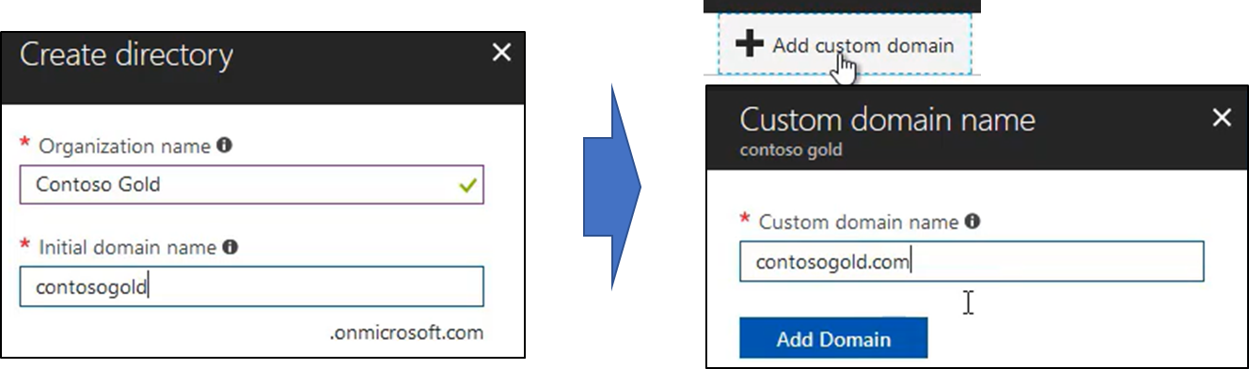
Domains
An Azure subscription has a domain - domainname.onmicrosoft.com
Add any routable custom domain name you control
Only Global administrators can perform domain management tasks
Domain names in Azure AD are globally unique
A custom domain name must be added and verified (next topic)

Slide 43
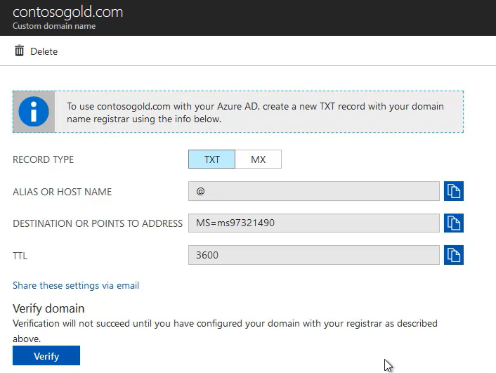
Verifying Custom Domain Names
Add the custom domain name (unverified state)
Add a DNS entry (TXT or MX)
Verify ownership of the custom domain name by checking for the DNS record in the registered domain
Notes:
✔️ An upcoming demonstration shows how to add the DNS record to your domain.
For more information, you can see:
Managing custom domain names in your Azure Active Directory - https://docs.microsoft.com/en-us/azure/active-directory/active-directory-domains-manage-azure-portal

Slide 44
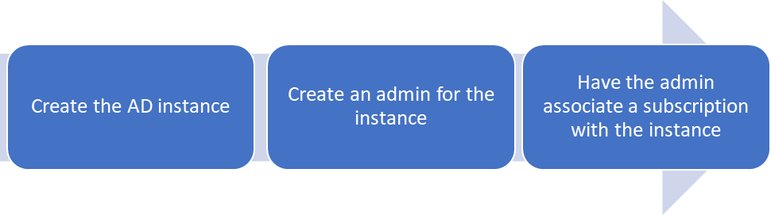
Tenants
A tenant is a dedicated instance of Azure AD
Houses the users in a company and their information
Can have multiple tenants, each with a different purpose
The steps are straightforward (upcoming video)
Notes:
✔️ An upcoming demonstration shows how to create a tenant, add an admin, and associate a subscription.
For more information, you can see:
How to get an Azure Active Directory tenant - https://docs.microsoft.com/en-us/azure/active-directory/develop/active-directory-howto-tenant

Slide 45
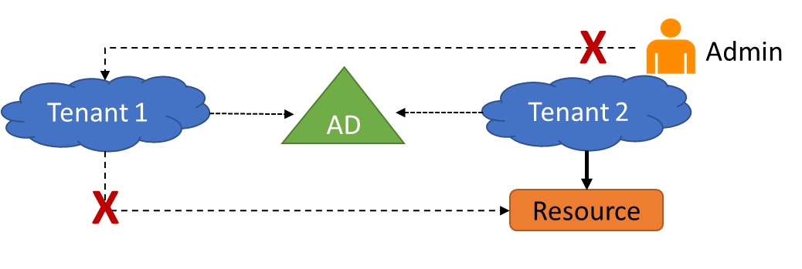
Multiple Tenants
Each tenant is a fully independent resource
This independence between tenants includes resource independence, administrative independence, and synchronization independence
Notes:
✔️ Unlike other Azure resources, your tenants are not child resources of an Azure subscription.
For more information, you can see:
Understand how multiple Azure Active Directory tenants interact - https://docs.microsoft.com/en-us/azure/active-directory/active-directory-licensing-directory-independence

Slide 46
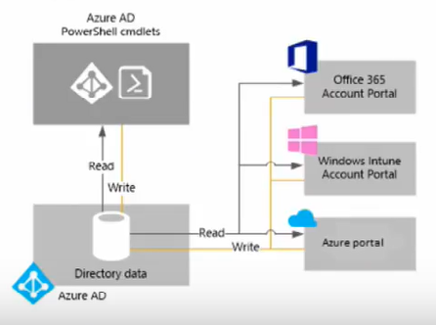
Managing Domains, Directories, and Tenants
An Azure tenant is a dedicated instance of an Azure AD directory
An Azure AD tenant directory is created when you sign up for a cloud service, such as Office 365 or Azure
Each Azure AD directory is:
Separate and distinct from other Azure AD directories
Designed for exclusive use by tenant organization
Customer data and identity information is isolated
Notes:
Managing Domains, Directories, and Tenants - https://www.youtube.com/embed/XtijSD-3iqc

Slide 47
Custom Domain Names
Before you can add a custom domain name, you must create your domain name with a domain registrar.
Adding a custom domain name to your directory
Adding a DNS entry for the domain name at the domain name registrar
Verifying the custom domain name in Azure AD
Troubleshooting steps: wait for propagation, double check the DNS record information, and ensure the domain name does not exist somewhere else
Notes:
QuickStart: Add a custom domain name to Azure Active Directory – https://docs.microsoft.com/en-us/azure/active-directory/add-custom-domain
For more information, you can see:
Manage custom domain names - https://docs.microsoft.com/en-us/azure/active-directory/active-directory-domains-manage-azure-portal

Slide 48
Lesson 02: Azure Users and Groups

Slide 49
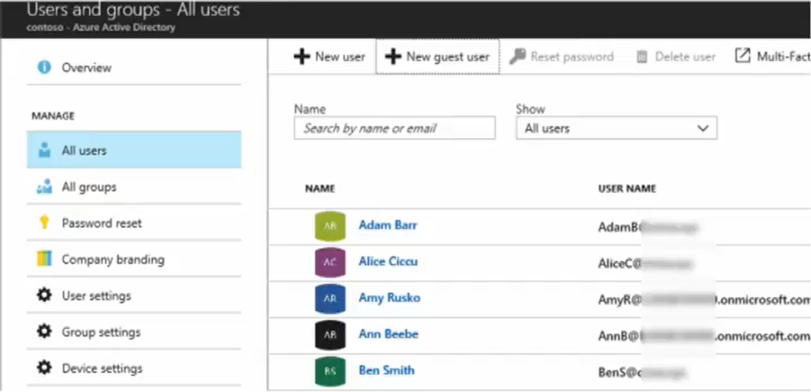
Managing Users and Groups
Notes:
Managing Users and Groups - https://www.youtube.com/embed/_fI1N0YL-Tk

Slide 50
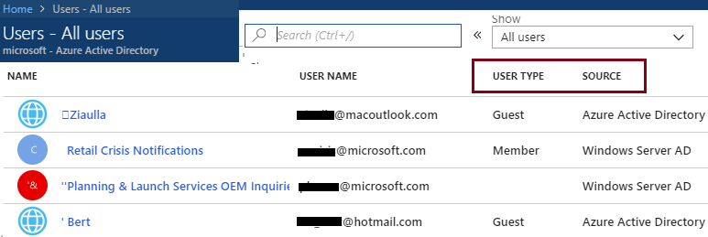
User Accounts
All users must have a user account
Contains all the information to authenticate and authorize the user
Different identity sources: cloud identities, directory-synchronized identities, and guest users.
Notes:
✔️ Take a minute to access the Portal and view your users. Notice the User Type and Source columns. Have you given any thought as to the type of users you will need?

Slide 51
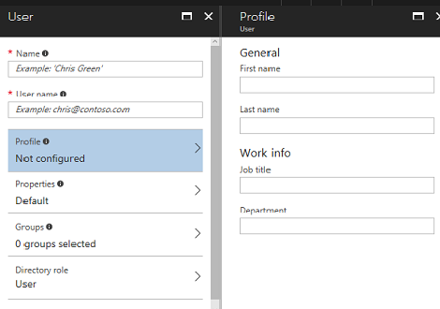
Adding User Accounts
# Create a password object
$PasswordProfile = New-Object -TypeName Microsoft.Open.AzureAD.Model.PasswordProfile
# Assign the password
$PasswordProfile.Password = "<Password>“
# Create the new user
New-AzureADUser -AccountEnabled $True -DisplayName "Abby Brown" -PasswordProfile $PasswordProfile -MailNickName "AbbyB" -UserPrincipalName "AbbyB@contoso.com"
Notes:
✔️ Users can also be added to Azure AD through Portal, Office 365 Admin Center, Microsoft Intune admin console, and the CLI. Which of the options mentioned in this topic do you prefer?
For more information, you can see:
Add or change profile information for a user in Azure Active Directory - https://docs.microsoft.com/en-us/azure/active-directory/active-directory-users-profile-azure-portal
Creating a new user in Azure AD - https://docs.microsoft.com/en-us/powershell/azure/active-directory/new-user-sample?view=azureadps-2.0
az ad user create - https://docs.microsoft.com/en-us/cli/azure/ad/user?view=azure-cli-latest#az_ad_user_create

Slide 52
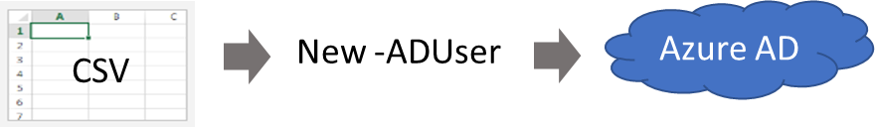
Bulk User Accounts (CSV File)
Use Connect-AzureAD to create a PowerShell connection to your directory
Create a new Password Profile for the new users
Use Import-CSV to import the csv file
Loop through the users in the file constructing the user parameters
Use New-ADUser to create each user
Be sure to enable each account
✔️ Try the PowerShell script in the reference link
Notes:
✔️ Implement a naming convention for usernames, display names and aliases. Implement a convention for the initial password of the newly created user.
For more information, you can see:
Importing data into my directory - https://docs.microsoft.com/en-us/powershell/azure/active-directory/importing-data?view=azureadps-2.0
New-ADUser - https://docs.microsoft.com/en-us/powershell/module/azuread/new-azureaduser?view=azureadps-2.0

Slide 53
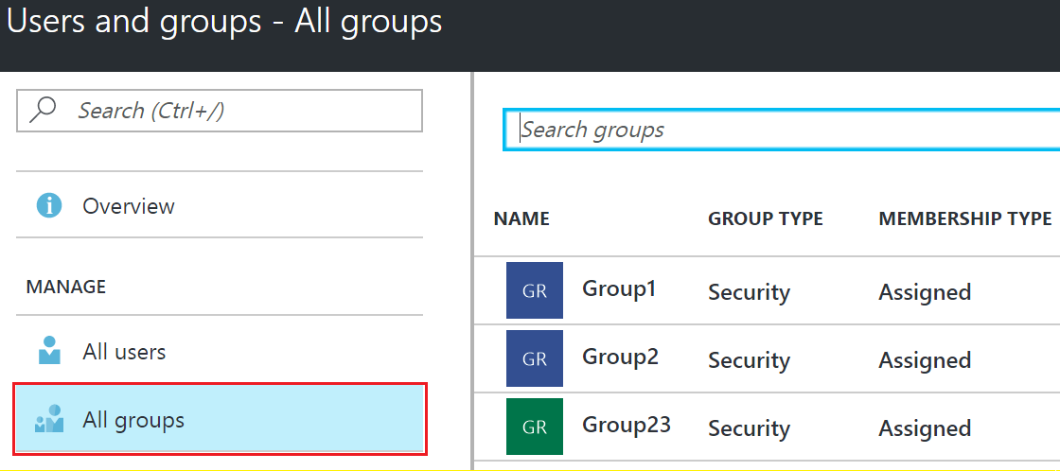
Group Accounts
Two types of groups: security and distribution
Two ways to add members: assign directly and assign dynamically
For PowerShell, New-AzureADGroup
Notes:
✔️ Have you given any thought to which groups you need to create? Would you directly assign or dynamically assign membership?
For more information, you can see:
Manage group membership for users in your Azure Active Directory tenant - https://docs.microsoft.com/en-us/azure/active-directory/active-directory-groups-members-azure-portal
Create attribute-based rules for dynamic group membership in Azure Active Directory - https://docs.microsoft.com/en-us/azure/active-directory/active-directory-groups-dynamic-membership-azure-portal
Create a group and add members in Azure Active Directory - https://docs.microsoft.com/en-us/azure/active-directory/active-directory-groups-create-azure-portal
New-AzureADGroup - https://docs.microsoft.com/en-us/powershell/module/azuread/new-azureadgroup?view=azureadps-2.0

Slide 54
Lesson 03: Azure Roles

Slide 55
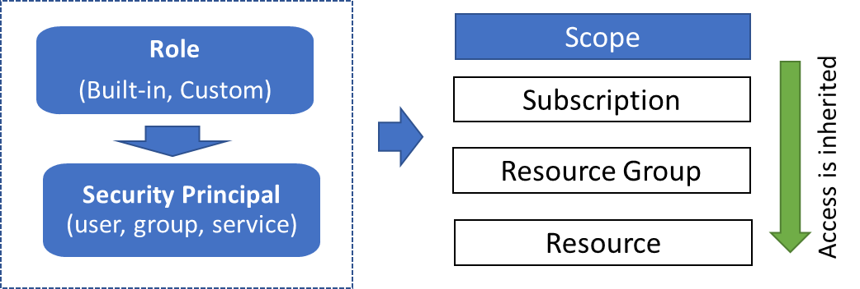
Role-Based Access Control
Provide access to administrators based on their assigned tasks
Define what actions are allowed and/or denied
Associate the role with a user, group or service principal
Scope to a subscription, a resource group, or specific resources
Notes:
Role-Based Access Control is also covered in the Managing Subscriptions and Resource course.
✔️ Notice that access is inherited from subscriptions, to resource groups, and then to resources.
For more information, you can see:
Get started with access management in the Azure portal: https://docs.microsoft.com/en-us/azure/active-directory/role-based-access-control-what-is

Slide 56
Role Assignment
Users
Assigned to organizational users in the AD associated with the subscription
Or, external Microsoft accounts in the same directory
Groups
Assigned to Azure AD security groups
Best practice: manage access through groups, adding roles, and assigning users
Service Principals
Service identities represented as service principals in the directory
Authenticate with Azure AD and securely communicate with one another
Notes:
✔Explain the benefits of role assignment that allows you to associate a security principal to a role, and how this decoupling lets you specify a specific role has access to a resource in your subscription. Also to add/remove security principals in a loosely connected manner.

Slide 57
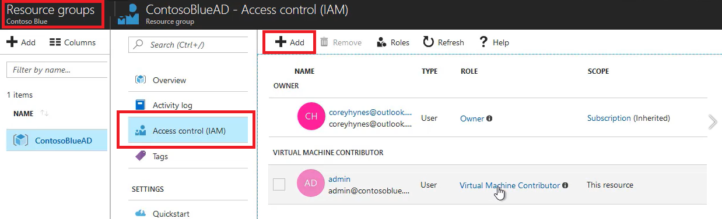
Built-in Roles (Portal)
Owner can manage everything, including access
Contributors can manage everything except access
Readers can view everything but can't make changes
Notes:
✔️ Take a minute to open the Azure Portal, open the Subscriptions or Resource Group blade, and click Access Control (IAM). Click Add and take a few minutes to review the built-in roles and see which role you would be most interested in using.
For more information, you can see:
Built-in roles in Azure - https://docs.microsoft.com/en-us/azure/role-based-access-control/built-in-roles
Create custom roles for Azure Role-Based Access Control - https://docs.microsoft.com/en-us/azure/active-directory/role-based-access-control-custom-roles
Get-AzureRmRoleDefinition - https://docs.microsoft.com/en-us/powershell/module/azurerm.resources/get-azurermroledefinition?view=azurermps-5.3.0

Slide 58
Role Definitions
Built-in Role | Action | NotActions
Owner (allow all actions) | *
Contributor (allow all actions except writing or deleting role assignment) | * | Microsoft.Authorization/*/Delete, Microsoft.Authorization/*/Write, Microsoft.Authorization/elevateAccess/Action
Reader (allow all read actions) | */read
Name : Owner
ID : 8e3af657-a8ff-443c-a75c-2fe8c4bcb65
IsCustom : False
Description : Manage everything, including access to resources
Actions : {*}
NotActions : {}
AssignableScopes : {/}
Notes:
✔️ Take a minute to open the Azure Portal, open the Subscriptions or Resource Group blade, and click Access Control (IAM).
Click Add and take a few minutes to review the built-in roles and see which role you would be most interested in using.
For more information, you can see:
Built-in roles in Azure - https://docs.microsoft.com/en-us/azure/role-based-access-control/built-in-roles
Create custom roles for Azure Role-Based Access Control - https://docs.microsoft.com/en-us/azure/active-directory/role-based-access-control-custom-roles
Get-AzureRmRoleDefinition - https://docs.microsoft.com/en-us/powershell/module/azurerm.resources/get-azurermroledefinition?view=azurermps-5.3.0

Slide 59
Assignable Scopes
You must properly scope your role
Example 1 - Make a role available for assignment in two subscriptions.
“/subscriptions/c276fc76-9cd4-44c9-99a7-4fd71546436e”, “/subscriptions/e91d47c4-76f3-4271-a796-21b4ecfe3624”
Example 2 - Make a role available for assignment only in the Network resource group.
“/subscriptions/c276fc76-9cd4-44c9-99a7-4fd71546436e/resourceGroups/Network”
Notes:
✔️ Take a minute to open the Azure Portal and use the Access Control blade to add a role and then assign it to a user. For your organization which role assignments would you need?
For more information, you can see:
Custom roles access control - https://docs.microsoft.com/en-us/azure/active-directory/role-based-access-control-custom-roles#custom-roles-access-control

Slide 60
Users and Groups (PowerShell and CLI)
#Role assignment properties – large numbers of users
$roleName = “Contributor”
$assigneeName = josh@microsoft.com
$resourceGroupName = “contosoblue”
# PowerShell role assignment
New-AzureRmRoleAssignment -RoleDefinitionName $roleName -SignInName $assigneeName -ResourceGroupName $resourceGroupName
# CLI role assignment
az role assignment create –role $roleName –assignee $assigneeName –resource-group $resourceGroupName
Notes:
✔️ If you have created a custom JSON role definition file you can use PowerShell or the CLI to create a new custom role definition. View the student notes for the code example.

Slide 61
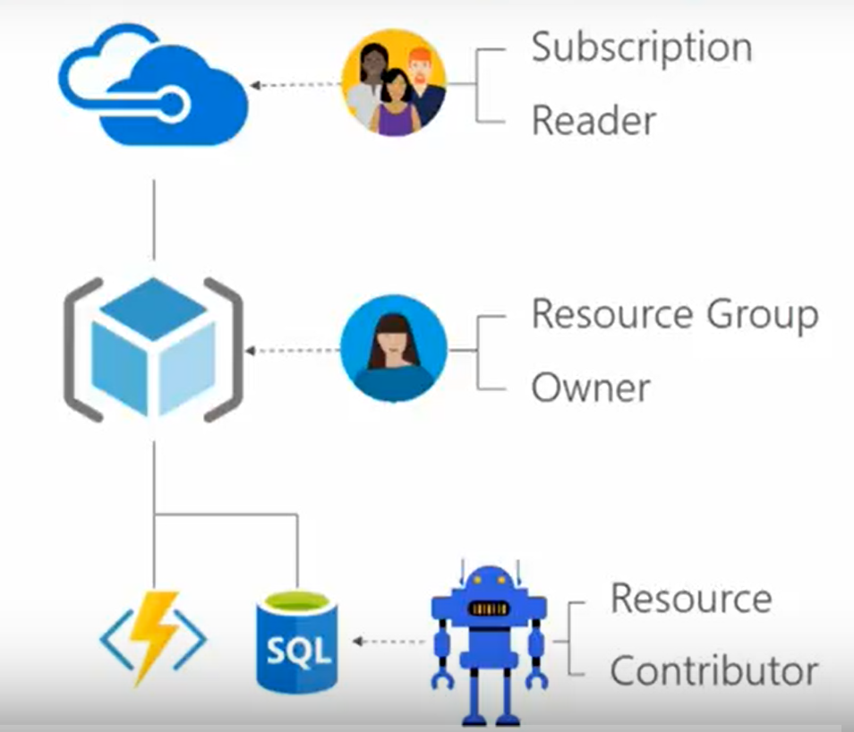
Role-Based Access Control

Slide 62
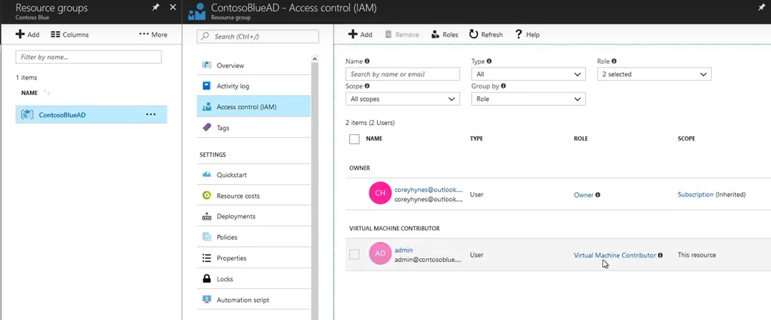
Role-Based Access Control

Slide 63
Lab 2A: RBAC
(Azure Portal) Grant access for a user using RBAC
Create a resource group
Assign a user to a role
Remove the role assignment
(PowerShell) Grant a user access to view resources in a subscription
Create a user
Create a resource group
List the role assignments: Get-AzureRMRoleAssignment
Remove access: Remove-AzureRmResourceGroup
Notes:
For more information, you can see:
What is role-based access control - https://docs.microsoft.com/en-us/azure/role-based-access-control/overview

Slide 64
Lesson 04: Managing Devices

Slide 65
Device Management
Azure AD enables SSO to devices from anywhere (BYOD)
Option 1: Registering a device
Enable a registered device to authenticate when the user signs-in
Disable the device, as needed
Option 2: Joining a device
Extends a registered device - all the benefits of registration
Changes the local state of device
Sign-in using an organizational work or school account instead of a personal account.
Notes:
✔️ Registration combined with a mobile device management (MDM) solution such as Microsoft Intune, provides additional device attributes in Azure AD. This allows you to create conditional access rules that enforce access from devices to meet your standards for security and compliance.
For more information, you can see:
Introduction to device management - https://docs.microsoft.com/en-us/azure/active-directory/device-management-introduction
Azure registered devices - https://docs.microsoft.com/en-us/azure/active-directory/device-management-introduction#azure-ad-registered-devices

Slide 66
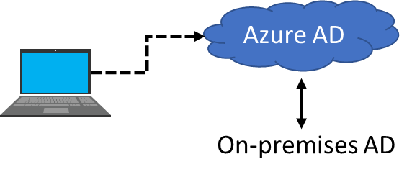
AD Join (Benefits)
Single-Sign-On (SSO) to your Azure managed SaaS apps and services
Enterprise compliant roaming of user settings across joined devices
Access to Windows Store for Business
Windows Hello support
Restriction of access to apps from only compliant devices
Seamless access to on-premise resources
Notes:
✔️ Although AD Join is intended for organizations that do not have on-premises Windows Server Active Directory infrastructure it can be used for other scenarios like branch offices. Read more at the reference link.
For more information, you can see:
Azure AD joined devices – https://docs.microsoft.com/en-us/azure/active-directory/device-management-introduction#azure-ad-joined-devices

Slide 67
Hybrid AD Joined Devices
 | Registered Devices | Azure AD Joined Devices | Hybrid AD Joined Devices
Device Type | Personal | Organization owned | Organization owned
Registration | Manual | Manual | Automatic
Operating System | Windows 10 | Windows 10 | Windows 7, 8, and 10
Devices joined to both devices on-premises AD and Azure AD
Central management of work-owned
Users to sign in to their devices with their AD work or school accounts
Notes:
✔️ Are you understanding the different types of joined devices? Which do you think your organization needs?
For more information, you can see:
Hybrid Azure AD joined devices - https://docs.microsoft.com/en-us/azure/active-directory/device-management-introduction#hybrid-azure-ad-joined-devices

Slide 68
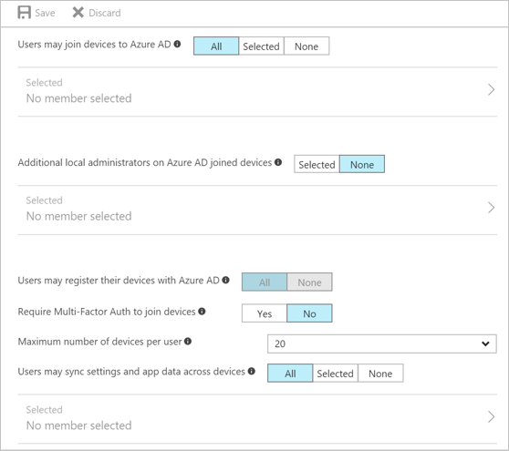
Managing Devices (Configuration Parameters)
Select the users who can join devices to Azure AD
Select the users that are granted local administrator rights on a device
Allow Azure AD joined or hybrid Azure AD joined to register with Azure AD
Require MFA to join devices
Select the maximum number of devices a user can have
Allow user’s settings and app data to sync across their Windows 10 devices
Notes:
For more information, you can see:
Usage scenarios and deployment considerations for Azure AD Join - https://docs.microsoft.com/en-us/azure/active-directory/devices/azureadjoin-plan

Slide 69
Lab 2B: Managing Devices (Portal) 2B
Use the Azure portal to access the Devices blade
Configure device settings
Locate devices
Perform device management tasks, such as Delete and Disable
Review the device audit logs
Notes:
Managing devices using the Azure portal - https://docs.microsoft.com/en-us/azure/active-directory/device-management-azure-portal

Slide 70
AZ-100.5 Module 03: Implementing and Managing Hybrid Identities

Slide 71
Lesson 01: Azure AD Integration Options

Slide 72
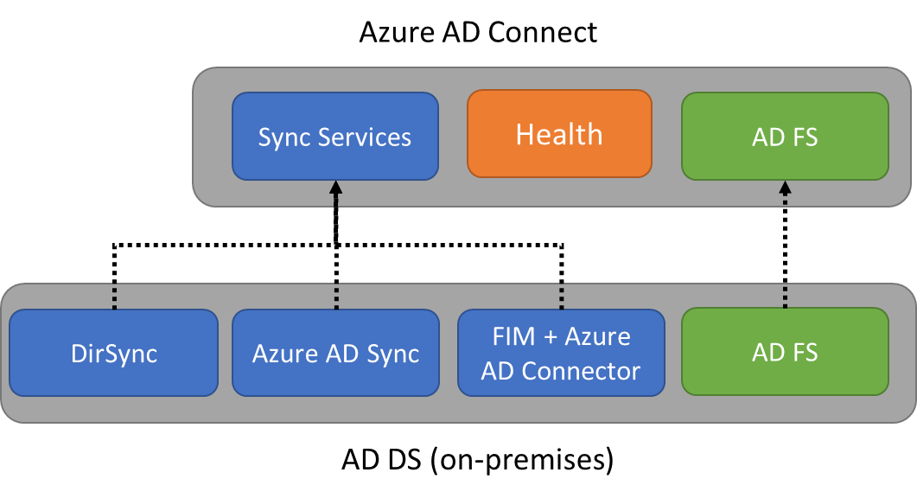
Azure AD Connect
Integrates on-premises directories with Azure Active Directory
Sync Services creates and syncs users, groups, and objects
Azure AD Connect Health provides central location monitoring
AD FS is optional for hybrid scenarios
Notes:
For more information, you can see:
Integrate your on-premises directories with Azure Active Directory - https://docs.microsoft.com/en-us/azure/active-directory/connect/active-directory-aadconnect

Slide 73
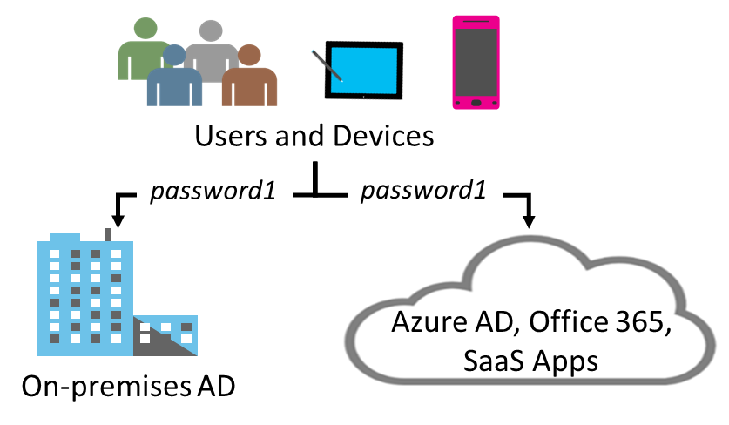
Password Synchronization
Password hash synchronizes user passwords from on-premises Active Directory to cloud-based Azure AD
Sign in to Azure AD services using the on-premises password
Improve the productivity of your users and reduce your helpdesk costs
Notes:
For more information, you can see:
What is password synchronization - https://docs.microsoft.com/en-us/azure/active-directory/connect/active-directory-aadconnectsync-implement-password-synchronization#what-is-password-synchronization

Slide 74
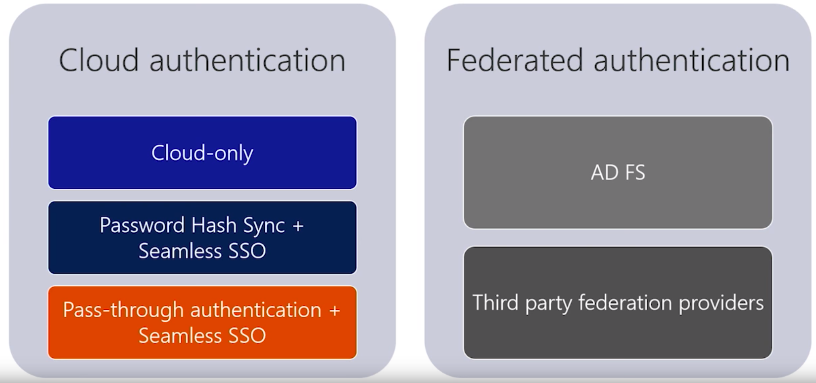
Choose the Right Authentication Option
Notes:
Choose the Right Authentication Option - https://www.youtube.com/embed/YtW2cmVqSEw
Excellent video – take time to go through the details.

Slide 75
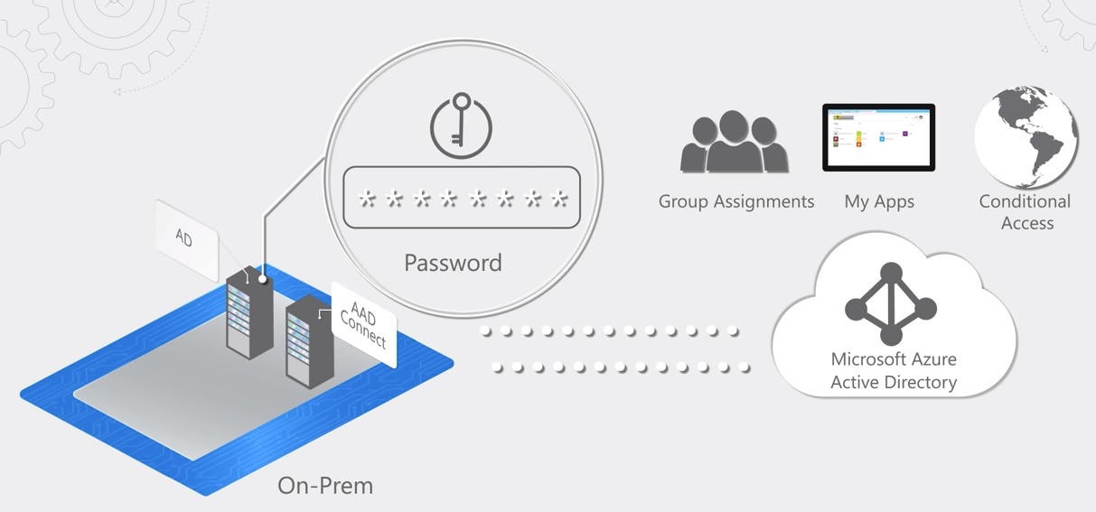
Azure AD Seamless Sign-On
Notes:
Azure AD Seamless Sign-On - https://www.youtube.com/watch?v=PyeAC85Gm7w&feature=youtu.be

Slide 76
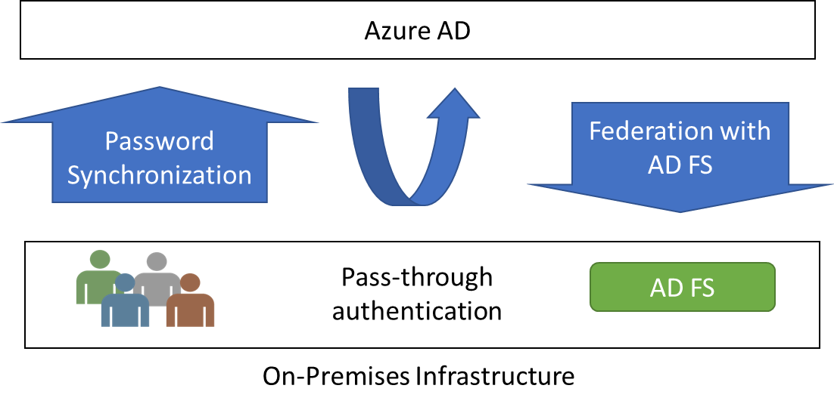
Sign-On Methods
Password Synchronization can synchronize an encrypted version of the password hash for user accounts
Pass-through authentication (PTA) authenticates the username and password with the on-premises domain controllers
AD FS is the Microsoft implementation of an identity federation solution that uses claims-based authentication
Notes:
For more information, you can see:
How password synchronization works - https://docs.microsoft.com/en-us/azure/active-directory/connect/active-directory-aadconnectsync-implement-password-synchronization#how-password-synchronization-works
User sign-in with Azure Active Directory Pass-through Authentication - https://docs.microsoft.com/en-us/azure/active-directory/connect/active-directory-aadconnect-pass-through-authentication
Deep-dive: Azure Active Directory Authentication and Single-Sign-On (video) - https://channel9.msdn.com/events/Ignite/Microsoft-Ignite-Orlando-2017/BRK3015?term=Azure%20AD%20Pass-through%20Authentication%20and%20Seamless%20Single%20Sign-on

Slide 77
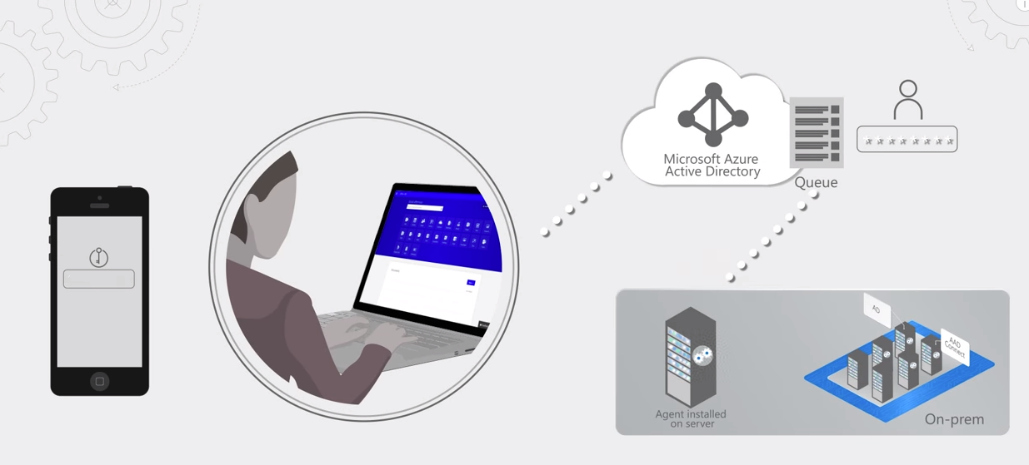
Pass-through Authentication
Notes:
Pass-through Authentication - https://youtu.be/vt2R4P4xLQA

Slide 78
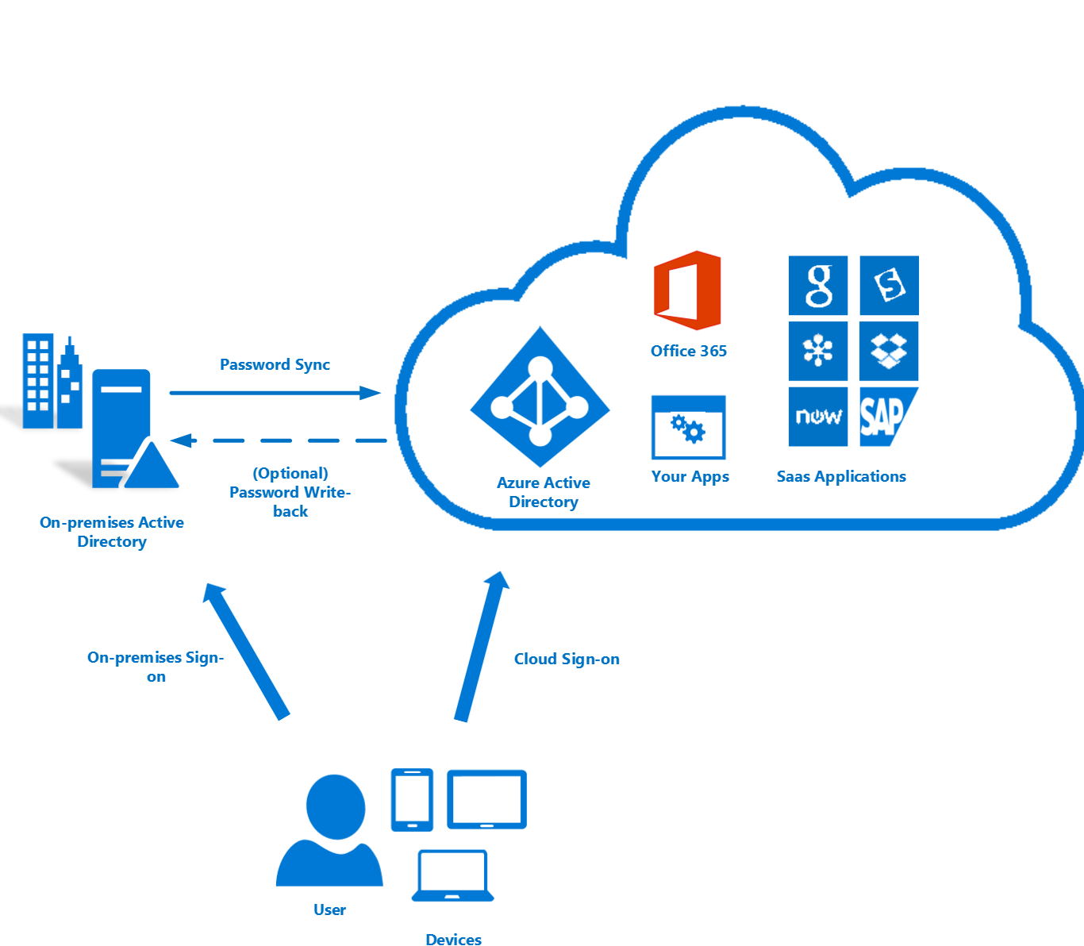
Azure AD DS Integration Options
Extend on-premises Active Directory to Azure
Requires replica of on-premises AD on an Azure virtual machine
Complex setup
Often used in “lift and shift” legacy app scenarios
Notes:
Azure AD DS Integration Options - https://www.youtube.com/embed/L9YtuV6FQuM

Slide 79
Lab 3A: Implement and Manage Hybrid Identities
Adatum Corporation wants to integrate its Active Directory with Azure Active Directory.
Deploy AD connect
Notes:
You need to decide where to offer this lab during the course. You can have students do the lab at the end of the course or wherever you determine it makes the most sense to do the individual exercises.

Slide 80
Lab 3B: Azure AD Pass-through
Verify prerequisites
Enable Pass-through authentication through Azure AD Connect
Notes:
Azure AD Pass-through Authentication - https://docs.microsoft.com/en-us/azure/active-directory/connect/active-directory-aadconnect-pass-through-authentication-quick-start
✔️ If you use this feature through a preview version, ensure that you upgrade the preview versions of the Authentication Agents by using the instructions provided in Azure Active Directory Pass-through Authentication: Upgrade preview Authentication Agents - https://docs.microsoft.com/en-us/azure/active-directory/connect/active-directory-aadconnect-pass-through-authentication-upgrade-preview-authentication-agents
For more information, you can see:
User sign-in with Azure Active Directory Pass-through Authentication - https://docs.microsoft.com/en-us/azure/active-directory/connect/active-directory-aadconnect-pass-through-authentication

Slide 81
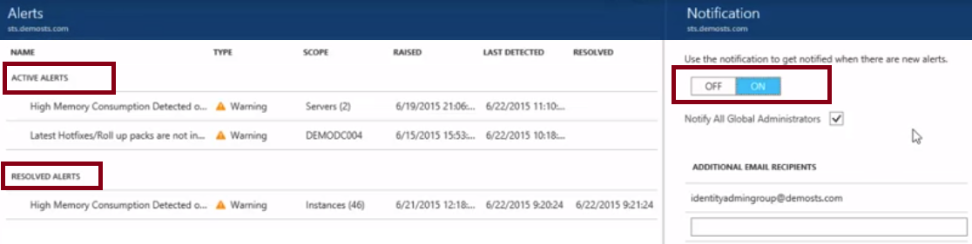
Azure AD Connect Health
AD FS servers, Azure AD Connect, and AD domain controllers
Synchronizations between your on-premises AD DS and Azure AD
On-premises identity access Office 365 or other Azure AD applications
View and act on alerts, setup email notifications for critical alerts, and view performance data.
Notes:
✔️ Using AD Connect Health works by installing an agent on each of your on-premises sync servers.
For more information, you can see:
Monitor your on-premises identity infrastructure and synchronization services in the cloud - https://docs.microsoft.com/en-us/azure/active-directory/connect-health/active-directory-aadconnect-health

Slide 82
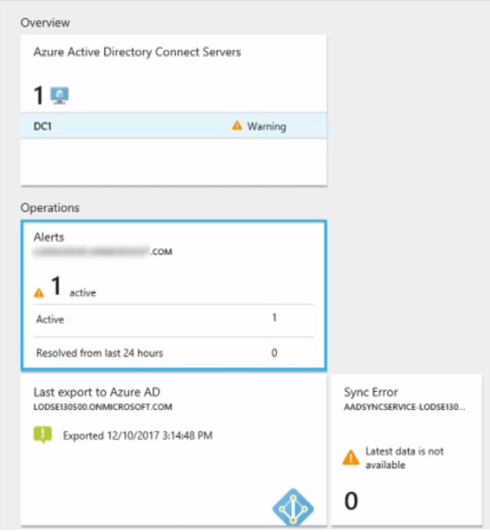
Monitoring Synchronization (Azure AD Health)
Azure AD Health for AD FS – relies on AD FS server agents, provides alerts and notifications, performance data and usage analytics
Azure AD Health for AD DS- relies on domain controller agents, provides alerts and notifications, has a dashboard with metrics
Azure AD Health for Sync – installed with Azure AD Connect, provides alerts and notifications, performance data and usage analytics
Notes:
Monitoring Synchronization using Azure AD Health - https://www.youtube.com/embed/ReYP6VT7Vlo

Slide 83
Lesson 02: Azure AD Application Proxy

Slide 84
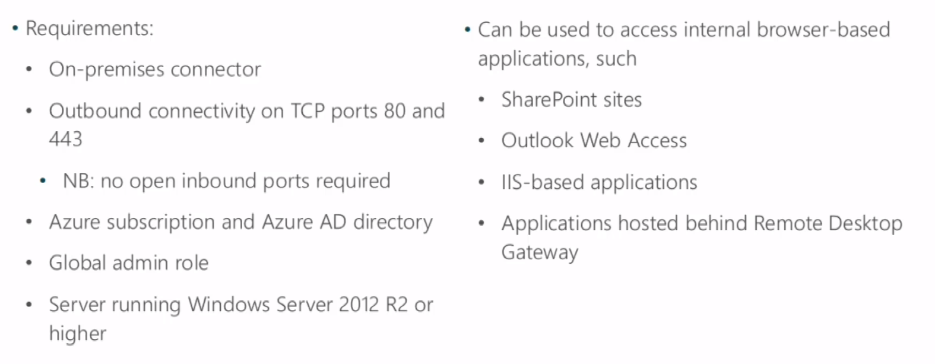
Application Proxy Overview
Notes:
Application Proxy Overview - https://www.youtube.com/embed/C40bvtHSGyM

Slide 85
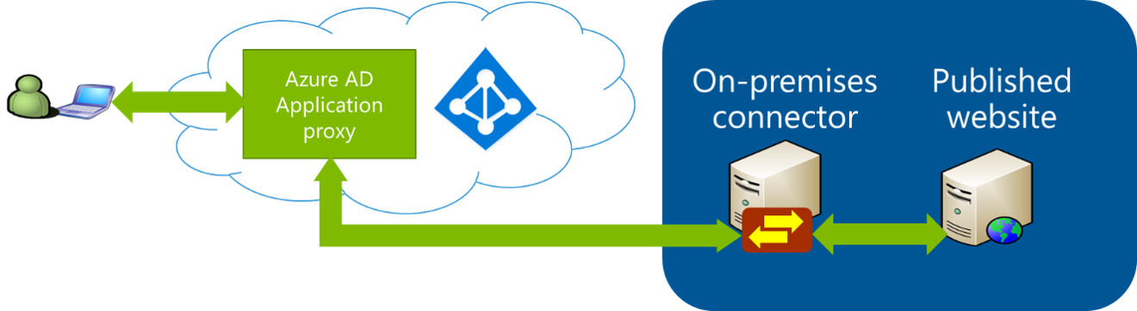
What is Azure Active Directory Application Proxy?
Provides remote access as a service - installed in the datacenter
Two connectors are recommended for greater resiliency
Windows Server 2012 R2 or higher on the on-premises connector
Don't need to change the network infrastructure
Notes:
For more information, you can see:
Azure AD Application Proxy Benefits - https://docs.microsoft.com/en-us/azure/active-directory/active-directory-application-proxy-get-started
Application Proxy Connections - https://docs.microsoft.com/en-us/azure/active-directory/application-proxy-understand-connectors

Slide 86
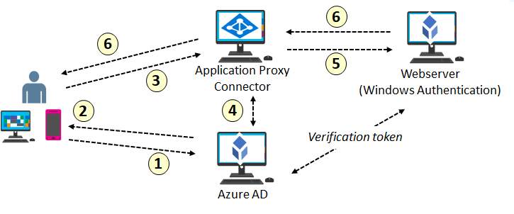
How Does Application Proxy Work?
Notes:
Use the student materials for the step descriptions.

